Slide 1
Introduction of SocketPro Framework for Node.js
Continuous Request Sending and Processing for the Highest Network Efficiency and Throughput
Yuancai (Charlie) Ye

Slide 2
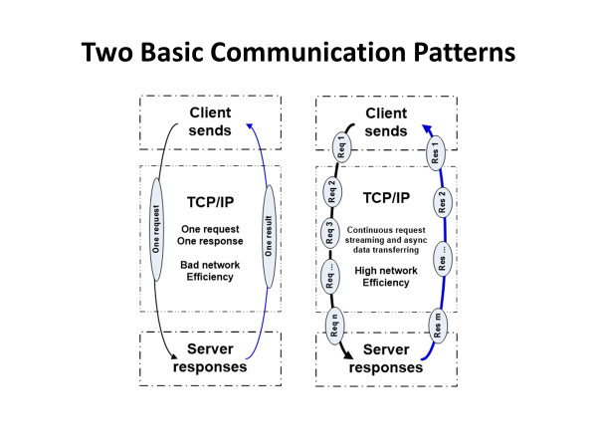

Slide 3
SocketPro Communication Architecture and Components
Client Core
cross-platform
native code
Server Core
cross-platform
native code
Request batching and streaming, asynchrony, secure, parallel communication on TCP/IP
C++
Adapter
.Net
Adapter
Java
Adapter
Python
Adapter
JavaScript
Adapter
PHP
Adapter
Node.js
Adapter
C++
Adapter
.Net
Adapter
Python
Adapter
Java
Adapter
User Client Code
User Server Code

Slide 4
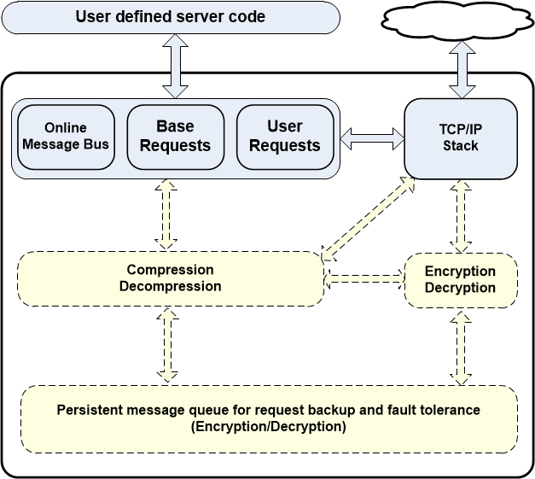
Client Core Features

Slide 5
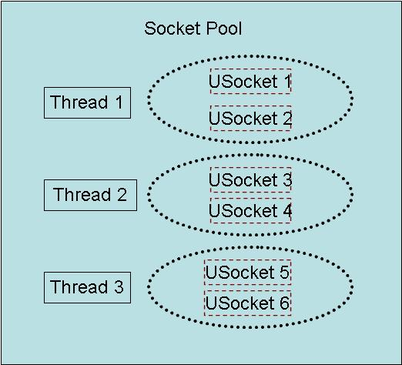
Client Socket Pool
A socket pool has three worker threads and each of these threads hosts two non-blocking sockets with fault tolerance for the best parallelism

Slide 6
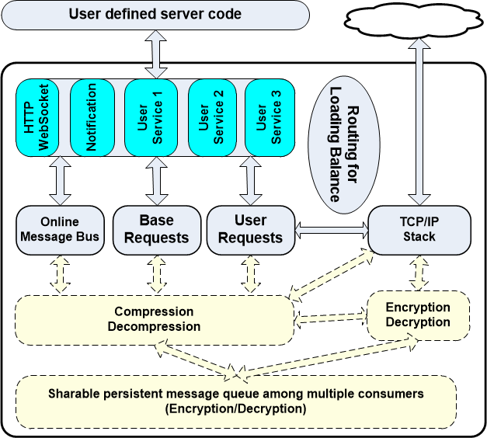
Server Core Features

Slide 7
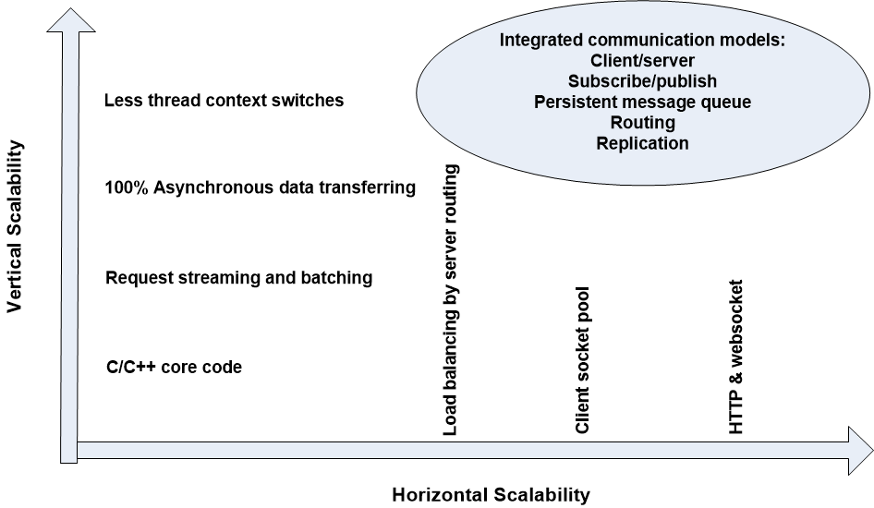
SocketPro Scalabilities

Slide 8
SocketPro Adapters for More Developers
C++ adapters – a few header and cpp files
One .NET adapter
Java adapter
Python adapter
Node.js adapter
One JavaScript adapter for browsers
PHP adapter in the future

